Slide 1
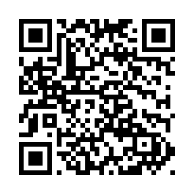
What is this??

Slide 2
7 Cs OF BUSINESS WRITING
COMPLETENESS
CONCISENESS
CONSIDERATION
CLARITY
CONCRETENESS
COURTESY
CORRECTNESS

Slide 3
COMPLETENESS
Answer all questions that are asked
Give something extra when desirable
Check for five Ws & one H
Who What When Where Why and How

Slide 4
Completeness
Dear All,
I just wanted to send you all a reminder about the meeting we're having tomorrow!
Hoping to see you there.
Charu

Slide 5
Completeness
Greetings all,
Just wanted to remind you about tomorrow's meeting on the new telecommuting policies. The meeting will be at 10:00 a.m. in the second-level conference room. Please let me know if you can't attend.
Hoping to see you there,
Regards,
Charu

Slide 6
CONCISENESS
1. Eliminate wordy expressions
2. Include only relevant statements
be focussed,
prune & avoid long explanations
avoid gushing politemess
3. Avoid unnecessary repetitions
use short forms the second time
use pronouns

Slide 7
Articulation - conciseness
Use concise words instead of normalized words
e.g.
Use analyze instead of ‘make an analysis of’
Use act instead of ‘take action on’
Use assume instead of ‘make assumptions about’
Exercise –
What would the concise expression be in each of the following cases?
Normalized words | Concise words
Give approval to
Be in a position to
Give consideration to
Make an implication that
Make a recommendation that
Make the suggestion that
Draw an inference that
With reference to

Slide 8
Articulation - conciseness
Use concise words instead of normalized words
e.g.
Use analyze instead of ‘make an analysis of’
Use act instead of ‘take action on’
Use assume instead of ‘make assumptions about’
Exercise –
What would the concise expression be in each of the following cases?
Normalized words | Concise words
Give approval to | Approve
Be in a position to | Can
Give consideration to | Consider
Make an implication that | Imply
Make a recommendation that | Recommend
Make the suggestion that | Suggest
Draw an inference that | Infer
With reference to | Refer

Slide 9
Articulation - Removing wordy phrases
Use single-word substitutes instead of phrases whenever possible without changing meanings.
E.g.
‘At this time’ replaced by now
‘For the purpose of’ replaced by for
‘In due course’ replaced by soon
Exercise –
What would the concise expression be in each of the following cases?
Normalized words | Concise words
Under the circumstances
In view of the fact that
In the event that
In spite of the fact that
For the reason that
In some cases
Please don’t hesitate to write
In many cases

Slide 10
Articulation - Removing wordy phrases
Use single-word substitutes instead of phrases whenever possible without changing meanings.
E.g.
‘At this time’ replaced by now
‘For the purpose of’ replaced by for
‘In due course’ replaced by soon
Exercise –
What would the concise expression be in each of the following cases?
Normalized words | Concise words
Under the circumstances | Because
In view of the fact that | Because
In the event that | If
In spite of the fact that | Although
For the reason that | Since
In some cases | Sometimes
Please don’t hesitate to write | Please write
In many cases | Often

Slide 11
Articulation - Removing wordy phrases
Normalized words | Concise words
Along the lines of
At the present time
For the purpose of
For the reason that
In accordance with
In the amount of
In the meantime
In the near future
In very few cases
In the view of the fact that
Normalized words | Concise words
On the basis of
On the occasion of
With regard to, with reference to
With a view to

Slide 12
Articulation - Removing wordy phrases
Normalized words | Concise words
Along the lines of | Like
At the present time | Now
For the purpose of | For
For the reason that | Because, since
In accordance with | By
In the amount of | For
In the meantime | Meanwhile
In the near future | Soon
In very few cases | Seldom
In the view of the fact that | Since, because
Normalized words | Concise words
On the basis of | By
On the occasion of | On
With regard to, with reference to | About
With a view to | to

Slide 13
CONSIDERATION
Focus on YOU instead of I & WE
Show reader benefit & interest
Emphasize positive& pleasant
Apply integrity & ethics

Slide 14
Write with a ‘you ‘ attitude , it shows consideration
I want to send my congratulations for ---
We will ship soon the goods your May 4 order----
We pay eight percent interest on -----

Slide 15
What you should say….
Would like to congratulate you…..
Your 4 of May order will be shipped soon….
An eight percent interest is being paid by us……

Slide 16
Avoid negative – unpleasant words to show consideration
It is impossible to open an account for you today.
He is very careless
She is very ungrateful
We don’t refund if the returned item is soiled and unusable.
When you travel on company expense, you will not receive approval for first class fare.
He is my ex-colleague.

Slide 17
Avoid negative – unpleasant words to show consideration
It is not possible to open an account for you today.
He is very not careful
She is very not grateful
We unable refund if the returned item is soiled and unusable.
If you travel on company expense, you are not entitled to receive approval for first class fare.
He is my former colleague.

Slide 18
CONCRETENESS
Use specific facts and figures
Put action into verbs
Choose vivid image building words by comparison & figurative language
Use more adjectives and adverbs

Slide 19
Concrete language
A significant loss
Good attendance record
The leading company
The majority
In the near future
Substantial amount
A 53 percent loss
100 percent attendance record
First among 3,212 competitors
62 percent
By noon Thursday
By day after tomorrow
$ 3,517,000

Slide 20
CLARITY
Choose short , familiar & conversational words
Construct effective sentences and paragraphs by unity of idea and sequencing
Achieve appropriate readability by using formal & informal language
Include examples, illustrations & visual aids

Slide 21
CLARITY
Dear Ramesh,
I wanted to write you a quick note about Mr.Sharma, who’s working in your department. He's a great asset, and I'd like to talk to you more about him when you have time.
Regards,
Suresh

Slide 22
CLARITY
Dear Ramesh,
I wanted to write you a quick note about Mr. Dheeraj Sharma, who's working in your department. In recent weeks, he's helped the IT department through several pressing deadlines on his own time.
We've got a tough upgrade project due to be completed over the next three months, and his knowledge and skills would prove invaluable. Could we please have his help with this work?
I'd appreciate speaking with you about this. When is it best to call you to discuss this further?
Regards,
Suresh

Slide 23
COURTESY
Be sincere , tactful, thoughtful and appreciative
Omit expressions that hurt , irritate, or insult
Grant apologies graciously

Slide 24
Show courtesy by avoiding tactless & blunt language.
Your letter is not clear at all:
Obviously, if you would read your policy carefully you will be able to answer these questions yourself.
Apparently you already forgotten what I wrote you two weeks ago.

Slide 25
Show courtesy by avoiding tactless & blunt language.
There is less clarity in your letter:
The policy is self-explanatory to answer your questions.
It seems you have forgotten what I wrote you two weeks ago.

Slide 26
CORRECTNESS
Use the right level of language
Check accuracy of facts, figures and words
Maintain acceptable writing mechanics
Choose non discriminatory language

Slide 27
Correct
Hi Mahesh,
Greetings!!!!
Thank you so much for meeting me today! I enjoyed our conservation, and I'm looking forward to moving ahead on our project. I'm sure that the two-weak deadline won't be an issue?
Thanks again, and I'll speak to you soon!
Best regards,
S.K.Roy

Slide 28
Correct
Hi Mahesh,
Greetings.
Thank you so much for meeting me today. I enjoyed our conversation and I'm looking forward to moving ahead on our project. I'm sure that the two-week deadline won't be an issue.
Thanks again, and I'll speak to you soon.
Best regards,
S.K.Roy

Slide 29

Net Etiquette

Slide 30
Attachments
Notes:
Explanation: Attachments can sometimes cause more headaches than help, and it can be difficult for the recipient(s) to figure out why they are unable to download an attachment. One way to help is to provide all of the important information about the file so that the recipient can trouble shoot to something more serious if there is a problem other than incompatibility.
Also, due to viruses that spread via e-mail attachments, it’s important that the recipient know that the sender meant for an attachment to be included with the message, and what kind of attachment it is, since opening unknown attachments could cause serious damage to the recipient’s system and spread viruses further. Always check any attachments you are going to send for viruses, and never open unknown attachments!

Slide 31
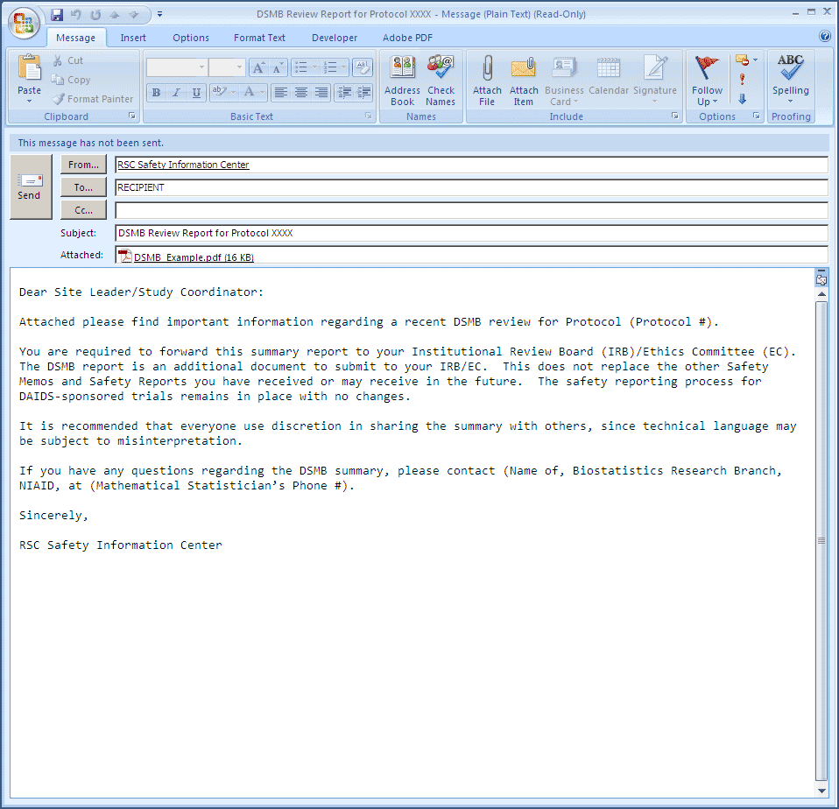

Slide 32
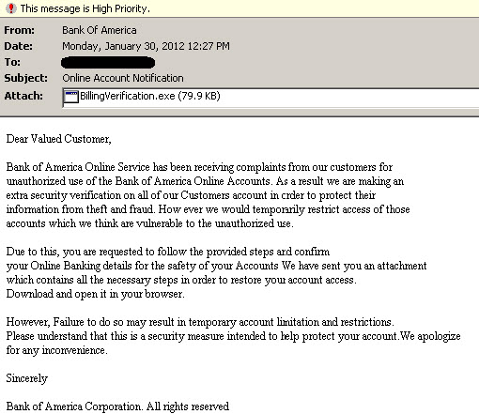

Slide 33
When your message is long
Create an “elevator” summary.
Provide a table of contents on the first screen of your email.
If you require a response from the reader then be sure to request that response in the first paragraph of your email.
Create headings for each major section.
Notes:
Mouse-click to activate text
Elevator Summary: Business experts often refer to this kind of summary either as an elevator summary or an executive summary. Either terminology is correct. An elevator summary is a summary that can be given to a colleague or employer in the short time it takes to get from the ground floor to the third floor on an elevator. It has the bare essentials of the message.
*Angell and Heslop
Why a summary? We all know what it is like to inundated with email, so much so that is difficult to figure out what emails have priority over others. If there is a brief summary at the top readers can make a decision about whether to save the email for later or finish it at that time.
The table of contents: The table of contents is a very friendly gesture toward readers when they are required to read long messages. It allows them to skip to the sections of the email that apply to them and avoid those areas that do not.
Other explanations: If the reader needs to respond immediately to the email then that should be conveyed in the first paragraph; otherwise, that message may be overlooked and the writer will not receive the response as quickly as one is needed.

Slide 34

Email Writing- How to Write a Long Informational Mail.

Slide 35
Elevator Summary and Table of Contents
An elevator summary should have all the main components of the email.
‘Our profit margin for the last quarter went down 5%. As a result I am proposing budget adjustment for the following areas, Please revert to me with your inputs at the earliest.’
Table of contents
“This email contains
A. Budget projections for the last quarter
B. Actual performance for the last quarter
C. Adjustment proposal
D. Projected profitability”
Notes:
Elevator summary activated by mouse-click, table of contents loads automatically
Sample: This slide shows examples of the elevator summary and the table of contents.
*Angell and Heslop

Slide 36
E-mail Writing 1
The client is wanting some information on the revised sections of your product XYZ, please write a mail telling him the same. (Please use the elevator technique).

Slide 37
Writing a complaint
You should briefly state the history of the problem to provide context for your reader.
Explain the attempts you made previously to resolve the problem.
Show why it is critical for the problem to be resolved by your reader.
Offer suggestions on ways you think it can be resolved or how you are willing to help in the matter.
Notes:
Mouse-click to activate text
Explanation: When writing a complaint via email the writer should provide a very clear picture for the recipient mainly because there is a tremendous amount of room for misinterpretation or misunderstanding. It is important that the writer provide a context and state clearly what the problem is and how he or she would like to see the problem resolved.
Reminder: Remind the participants that if the problem is urgent, they should indicate that in their elevator summary and let the recipient know they need a response as soon as possible.

Slide 38
Writing a complaint
Briefly state the history:
“The current way we choose managers for our organization is not democratic. As a result, we have a popularity contest that does not always get us the best candidates.”
Show attempts made by you thus far to resolve the issue:
“I have offered two alternatives for manager selection that still involves the votes of the members but both have been rejected by the executive board.”
Notes:
Mouse-click to activate text
Explanation: These are the first two steps one can take in writing a complaint. It is important for the writer to provide a context for his or her audience and to show the audience that he or she has taken all the necessary and required steps to resolve it. When a person takes the time to show that she or he is contributing to the solution the message takes on a positive tone that is generally received with greater ease and optimism by the audience.

Slide 39
Writing a complaint
Show why it is important for your reader to get involved:
“This is a problem for two reasons. First, I am concerned that the executive board no longer protects the interests of the organization and that their actions are not in keeping with the constitution of the organization.
Second, there have been a number of complaints from the members who feel that their concerns and preferences are not being addressed by the executive board, which decreases morale and productivity.”
Notes:
Explanation: Everyone does not agrees on what is considered to be a “problem.” When writers clearly state what they perceive to be troublesome it reduces the possibility of disagreement between them and their audience. Labeling something as a “problem” is not sufficient enough to motivate others to act. The problem must be clearly defined in a way that can foster solutions.

Slide 40
Writing a complaint
Ask for help and offer a resolution:
“Please let me know what other options I may have overlooked. I am willing to meet with the department head and the executive board to seek out a solution that is fair to the members and is good for the business of the organization. ”
Notes:
Explanation: Most often when people receive complaints the natural reaction is to ask “so how does this involve me?” It is vital that writers prescribe courses of action to motivate their audience. First, writers should concede that they may have overlooked an option; perhaps there are other ways to resolve the problem without calling meetings and sending out intimidating memos. Second, writers should show how they are willing to participate in the solution by suggesting their willingness to meet with a third party, the party in question, or others. This shows that writers have good will toward the organization.

Slide 41
Email Writing 2
The client has asked for a revision of the product and your team is not able to do the desired changes, write a mail to your superior asking for intervention as the client requirement is already delayed.

Slide 42
Subject Line
Headline (think newspaper).
Grab Attention.
Summarize message.
Make it easy for recipients to triage your Email and find it later.
Don’t “Reply All” to a message to grab addressees without changing subject.
Notes:
This is the area where most of us could do better.
Many of your correspondents are faced large numbers of Emails when they check their inboxes.
You need to make your message standowith ut and make it easy for the person to decide when to read your message.
A good subject line also makes it easier to locate you message later.
(Use Email to Region announcing election loss as example of last bullet.)

Slide 43
Rate These Subject Lines
Subject: Important! Read Immediately!!
Subject: Meeting
Subject: Follow-up About Meeting
Subject: Announcement
Subject: Room for Social meeting May 14?
Notes:
All but the last are too brief and general to determine what the message is about.

Slide 44
Different Ways of Writing a Subject Line
Subject:
Party planning meeting rescheduled for 3pm
Help: I can’t find the draft for the Sumit Jaiswal
Reminder: peer-review articles due tomorrow (3/30)
Questions about yesterday’s client call
Congratulations to Rahul for winning ‘Star of the Week’!

Slide 45


Subject:
Re: Questions about product revision. (was: please help with this!)
Change subject lines when necessary
Subject:
Re: Re: Re: [Fwd: [Fwd: [HrIDR] Reminder: Deadline for filling the ITR is Aug. ‘15]]
Remove extra email prefixes

Slide 46
Closing a Mail
Good Job!
All the best of success!
Have a great day!
Happy Holidays!
Keep up the good work!
Thank you!
Thank you for your quick response.
Thank you for taking your time.
Look forward to your reply.
Enjoy your weekend!
HTH! (Hope This Helps!)
Thanks on behalf of_____________

Slide 47
Closing a Mail
Best,
Cheers,
Cordially,
Regards,
Best regards,
Best wishes,
Sincerely,
Kindest regards,
Warmest regards,
Thanks again,
My sincere thanks for your time and consideration,
Take care,
Continued success,

Slide 48
10 Good Opening Lines….
With reference to your letter /email of 8 June, I …
I am writing to enquire about …
After having seen your advertisement in … , I would like …
After having received your address from … , I …
I received your address from … and would like …
We/I recently wrote to you about …
Thank you for your letter/email of 8 May.
Thank you for your letter/email regarding …
Thank you for your letter/e-mail about …
In reply to your letter /emailof 8 May, …

Slide 49
10 Good Closing Lines
If you require any further information, feel free to contact me.
I look forward to your reply.
I look forward to hear from you.
I look forward to see you.
Please advise as necessary.
We look forward to a successful working relationship in the future.
Should you need any further information, please do not hesitate to contact me.
Once again, I apologise for any inconvenience.
We hope that we may continue to rely on your valued patronage.
I would appreciate your immediate attention to this matter.

Slide 50
Email Etiquette Quiz
Why shouldn't I type my e-mails in all caps?
A. All caps insinuates you are adding very strong emphasis or yelling.
B. It makes you look lazy.
C. It is a strain on your eyes and makes reading your e-mail more difficult.
D. All of the above.

Slide 51
Email Etiquette Quiz
Why should I use the BCc field?
A. So I can send copies to my co-workers without my boss knowing.
B. To keep my e-mail looking clean.
C. To respect my contact's privacy.
D. So I can send copies to anyone I want.

Slide 52
Email Etiquette Quiz
How should I respond to a rude or insulting e-mail?
A. The next day when I've had time to create a calm and mature response.
B. Respond immediately and set things straight!
C. Never! Whats the point?
D. Report the Sender to their ISP.

Slide 53
Email Etiquette Quiz
Before sending a very large attachments, I should:
A. Compress the files (zip them up).
B. Send them first thing in the morning and call to make sure they were received.
C. Send large files only during week days.
D. Compress the files then ask first when would be the best time to e-mail them.

Slide 54
Email Etiquette Quiz
I should only forward e-mail when:
A. I feel it's important.
B. I know the other person should have the information.
C. The topic is commendable and important to all onliners.
D. I type a personal comment about why I am forwarding that specific e-mail to that specific person.

Slide 55
Email Etiquette Quiz
When is it okay to e-mail others about my business?
A. Only when they e-mail me first and ask me for information.
B. When I know they can use my service.
C. When I know I can save them a lot of money.
D. Anytime - that's called cold calling.

Slide 56
Email Etiquette Quiz
I should down edit my e-mail replies by
A. Removing previous signature files.
B. Removing the previous 2 e-mails noted in my reply.
C. Removing everything not necessary to the ongoing conversation.
D. Spell checking the sender's previous e-mail.

Slide 57
Email Etiquette Quiz
How quickly should I reply to e-mail?
A. As soon as I can; no longer than 24-48 hours.
B. When I get around to it.
C. I don't have to reply.
D. Doesn't matter.

Slide 58
monica.anand@theachieversacademy.in 09981500274
Thank you

